Slide 1
Datapath
Building a datapath
Datapath Stages
Instructions Reading
Registers and ALU. R-type instructions.
Data Memory. Load and Store instructions.
Brach Instructions
Creating a single datapath
Textbook P&H Ch.4. Datapath and Control.

Slide 2
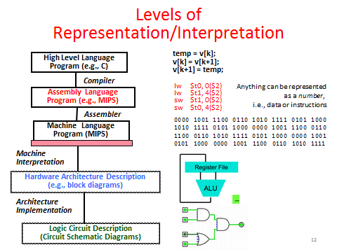

Slide 3
What is CPU and datapath ?
Processor (CPU): the active part of the computer that does all the work (data manipulation and decision-making)
Datapath: portion of the processor that contains hardware necessary to perform operations required by the processor (the brawn)
Control: portion of the processor (also in hardware) that tells the datapath what needs to be done (the brain)

Slide 4
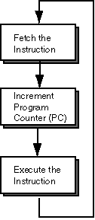
Building a Datapath One big datapath block or small ones.
The whole cycle of instruction execution should be implemented in datapath.
Problem: a single, atomic block that “executes an instruction” (performs all necessary operations beginning with fetching the instruction) would be too bulky and inefficient
Solution: break up the process of “executing an instruction” into stages, and then connect the stages to create the whole datapath
smaller stages are easier to design
easy to optimize (change) one stage without touching the others (modular structure)
Simple Machine Cycle.

Slide 5
Common and Specific parts of instructions
A reasonable way to start a datapath design is to examine the major components required to execute each class of MIPS instructions
Then create the common and the specific parts for each and finally for all instructions.
To execute any instruction, we must start by fetching the instruction from memory.
To prepare for executing the next instruction, we must also increment the program counter so that it points at the next instruction, 4 bytes later.
These are the main evidently common steps for all instructions
Simple Machine Cycle.

Slide 6
Five Stages of the Datapath
Stage 1: Instruction Fetch - IF
Stage 2: Instruction Decode - ID
Stage 3: ALU (Arithmetic-Logic Unit) - EX
Stage 4: Memory Access - MEM
Stage 5: Register Write - WB

Slide 7
Stages of the Datapath (1/5)
There is a wide variety of MIPS instructions: so what general steps do they have in common?
Stage 1: Instruction Fetch
no matter what the instruction, the 32-bit instruction word must first be fetched from memory
also, this is where we Increment PC (that is, PC = PC + 4, to point to the next instruction)

Slide 8
Stages of the Datapath (2/5)
Stage 2: Instruction Decode
upon fetching the instruction, we next gather data from the fields (decode all necessary instruction data)
first, read the opcode to determine instruction type and field lengths
second, read in data from all necessary registers
for add, read two registers
for addi, read one register
for jal, no reads necessary

Slide 9
Stages of the Datapath (3/5)
Stage 3: ALU (Arithmetic-Logic Unit)
the real work of most instructions is done here: arithmetic (+, -, *, /), shifting, logic (&, |), comparisons (slt)
what about loads and stores?
lw $t0, 40($t1)
the address we are accessing in memory = the value in $t1 PLUS the value 40
so we do this addition in this stage

Slide 10
Stages of the Datapath (4/5)
Stage 4: Memory Access
actually only the load and store instructions do anything during this stage; the others remain idle during this stage or skip it all together
since these instructions have a unique step, we need this extra stage to account for them
as a result of the cache system, this stage is expected to be fast

Slide 11
Stages of the Datapath (5/5)
Stage 5: Register Write
most instructions write the result of some computation into a register
examples: arithmetic, logical, shifts, loads, slt
what about stores, branches, jumps?
don’t write anything into a register at the end
these remain idle during this fifth stage or skip it all together

